Slide 1


Slide 2

Star Pours
….When you need guidance in the wide world of wine…
…When you’re standing in the wine aisle and cant remember the name of the bottle you tried last week…
…When you want to impress a certain someone, or a room full of someones..
….. When you need to know what Vino….
Notes:
Concept/motivation:
We’ve all been there… lost In the wine aisle wondering which to choose…
You don’t know jack $#!@ about wine….
..or maybe you know some $#!t…but not enough…

Slide 3

Obi Wine Kenobi
Behold…your own personal sommelier!
Notes:
Obi Wine Kenobi acts as a personal Sommelier to assist you in choosing a great bottle. You can browse through a multitude of vineyards. Get the winemaker’s notes about the product, straight from the vine to your computer, phone, or tablet. You can even save and edit wines for future consumption.
-Get Snooth reviews, Recipe pairings, a link to the vineyard/winemaker website.

Slide 4
Bottling the Forces of good and Evil:
Designating an MVP
What would you need to know about Wine
What would you want to know about wine
Obtaining API keys
Setting up functionality for Ajax calls
Aesthetic
Notes:
Design Process:::
We set a pretty lofty goal at first, so it was all about designating our MVP, and realizing what we could get accomplished within the week.
We finally obtained the api key from Snooth, which enabled us to only use two api’s to accomplish this site. We wanted to incorporate weather, but couldn’t find wan without either Oauth, or a hefty monthly usage fee.

Slide 5
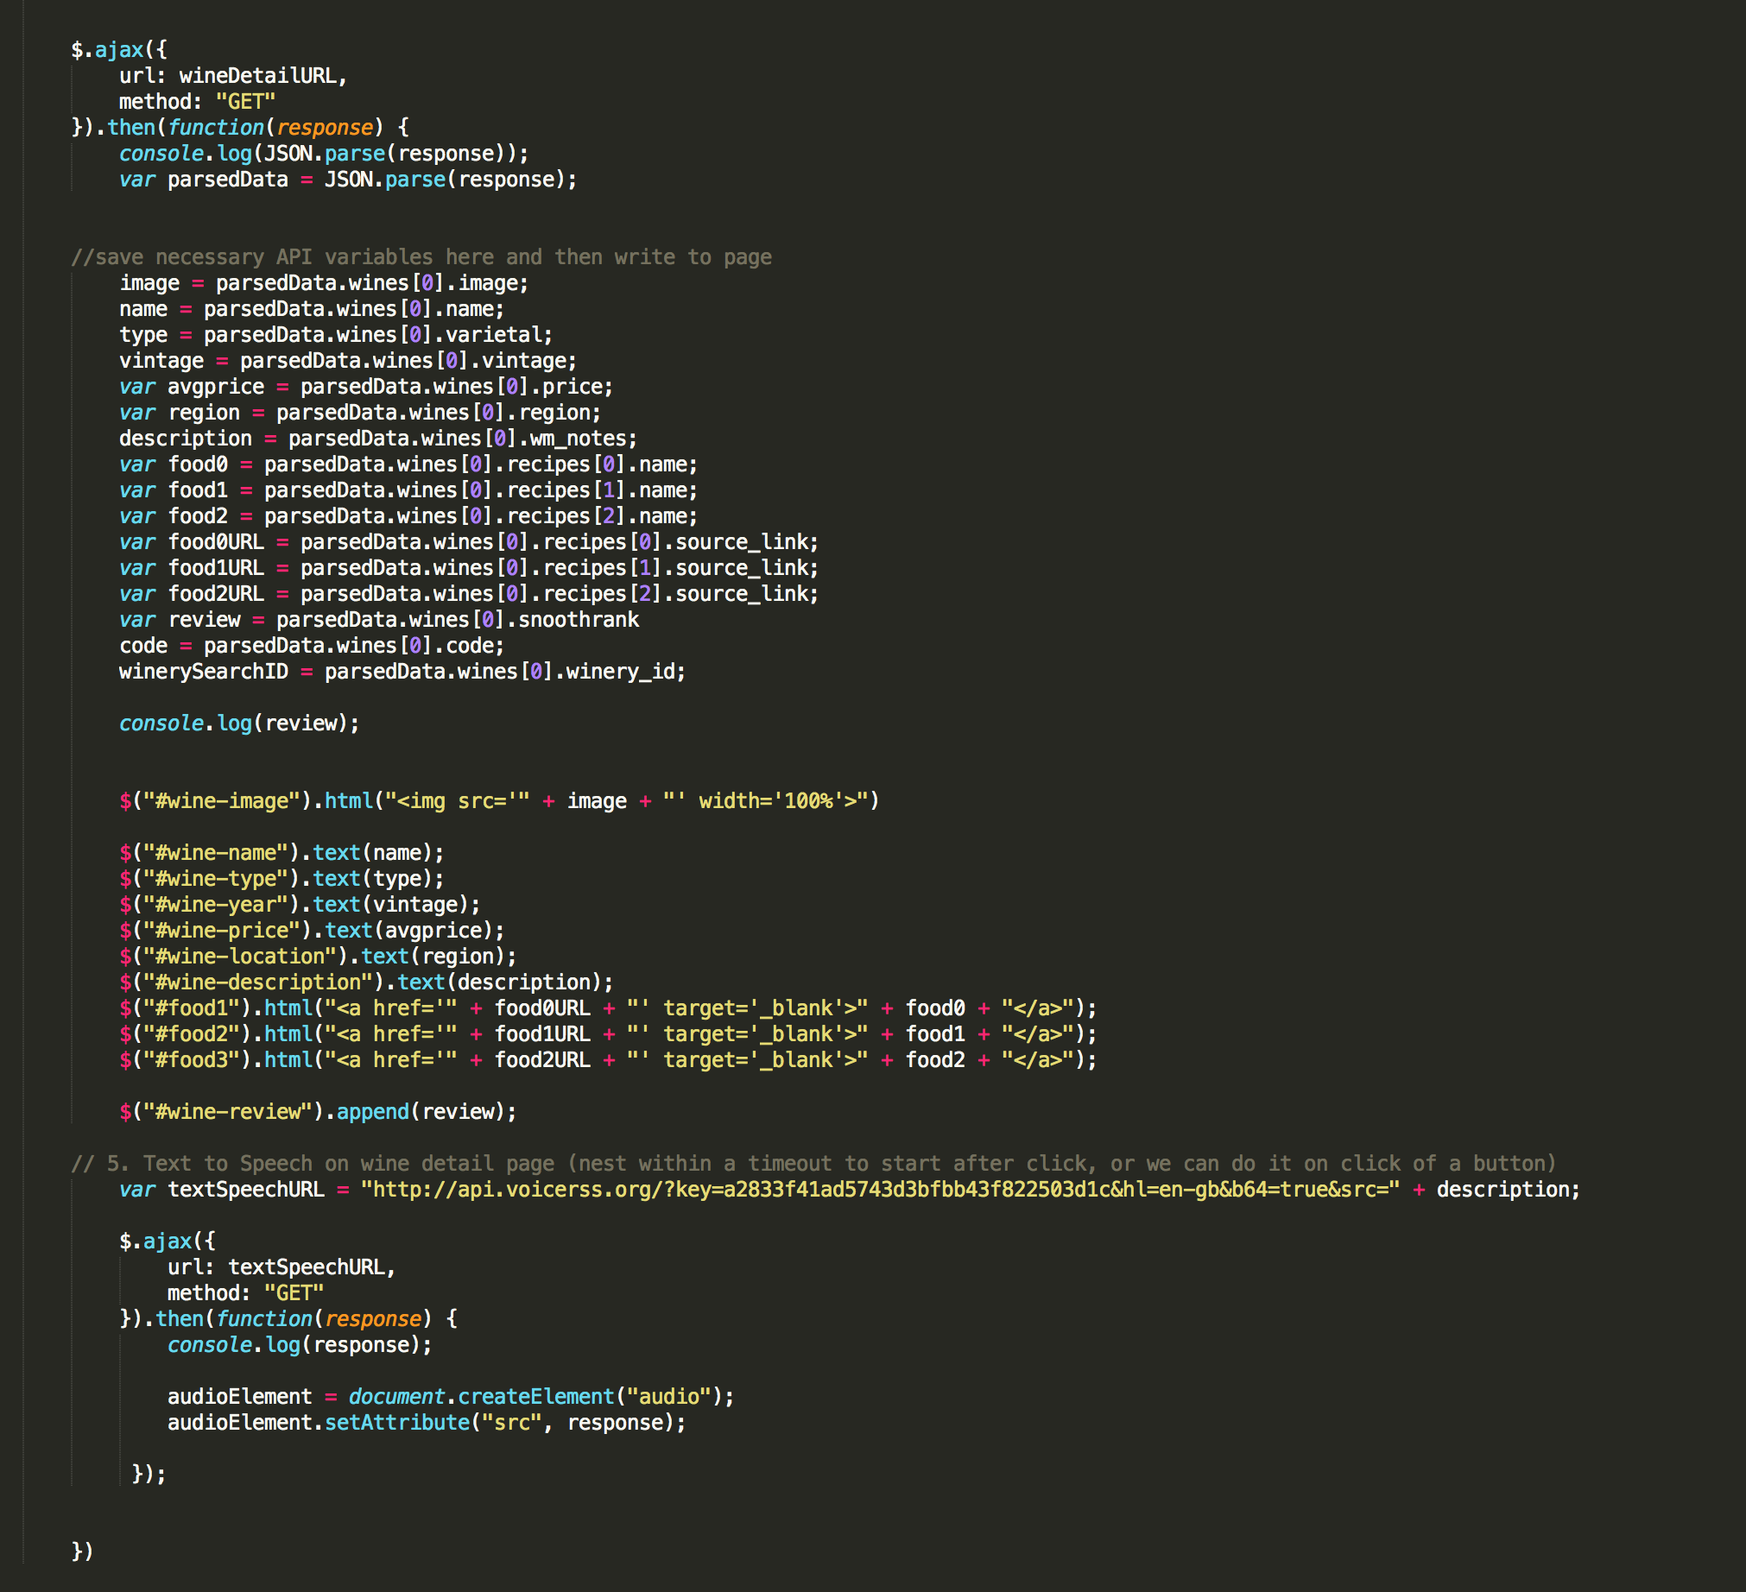
Wine by design
Notes:
Design::
API’s that we used include Snooth and Text-to-speech. The latter was pretty straight forward, but Snooth provided a wide array of information.
This page features food pairings as well as further wine detail Ajax calls. It also includes the text to speech Ajax call. We went through several text to–speech voices. We were hoping for a French accent, but settled with British to enhance user experience (it sounded much more sophisticated).

Slide 6
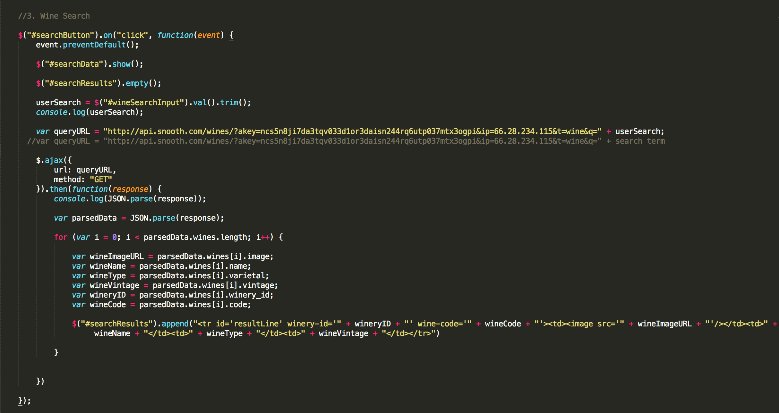
Wine and Design
Notes:
This page shows the main information displayed in the user search. We investigated other websites to see what the wine consumer would typically want to know about the product that they are searching. We used a modal to ask the user about their name and age before entering the site. Visitors who return to the site will be greeted with their name. This is done using local storage, which also saves the user’s favorite wine(s).

Slide 7
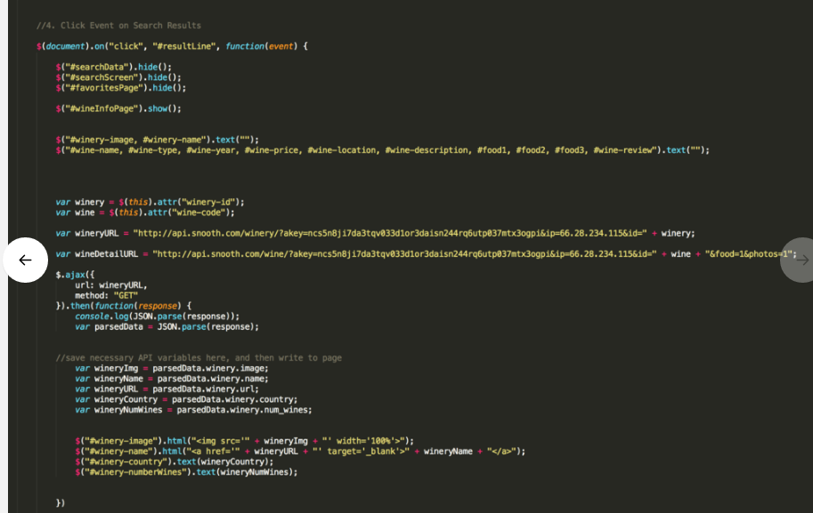
..More wining..
Notes:
Technologies: This shows our hide/show features that allow the page to run faster because the user does not need to reload the page each time they are browsing the site.
Some lessons that we learned via technology:
We found out that click events inside of click events will cause random misfires within site functionality. We also used gyphs to personalize the sommelier experience and give it a more comedic/personal feel. No need to be snooty here.
.

Slide 8
Obi Wine Kenobi
<add link here >
Notes:
Demo: link to working page here:
-Mobile Responsiveness…
-will check your name and age (makes sure to clear local storage before Demo!!!)
-can search wine::
Pinot: Golden Eye, Ten degrees
-will bring up suggested dinner pairings/recipies
-will give link to vineyard website
-will give a Snooth review
-heard it through the grapevine-listen to wine maker notes straight from the source
-add to favorites and take away from favorites if didn’t like a wine, or just want to try some new bottles
-can use back button to visit previous search results/start a new search without reloading the page
-average price
Shiraz:
(5th search option)
-select the second or third recipes
-vineyard link works
-has Snooth rating
Cabernet:
(7th search option)
-second recipe link works best
-link to vineyard
-has Snooth rating

Slide 9
…Star Pours: the Next Generation…
What if your sommelier IS the botttle...?
… Up next from the Obi Wine Kenobi group…
… Augmented reality and facial recognition would make it possible to have the face on your selected bottle do all of the talking…about itself…
…Bottle the force…
…And the force will always be with you….
Notes:
We would eventually have liked to add facial recognition, paired with an AR app that would recognize a specific array of pictures of labels. This would enable a user to select one of the specified wine bottles, and have the bottle tell the user directly about itself. It would look like the label was talking to you through a moving picture on your phone or computer. Similar to our Sommelier gyphs, but with the label, and more convincing speaking movements.
-username/auth on firebase.
(could use account to view site on multiple screens)
-Judgement of Paris:
-compare ratings, show trending wines, learn what others thought of each wine, through firebase, could put storage. i.e. “here’s what others thought of this product!”

